Slide 1
INT219
FRONT END WEB DEVELOPER
Lecture #0
The kick start session

Slide 2
Course Details
Course Code:- INT219
LTP:- 2 0 2 [2 lectures, 2 practical's /week]
Credits:- 3

Slide 3
Vision
To be a globally recognized school through excellence in teaching, learning and research for creating Computer Science professionals, leaders and entrepreneurs of future contributing to society and industry for sustainable growth.

Slide 4
Mission
To build computational skills through hands-on and practice-based learning with measurable outcomes.
To establish a strong connect with industry for in-demand technology driven curriculum.
To build the infrastructure for meaningful research around societal problems.
To nurture future leaders through research-infused education and lifelong learning.
To create smart and ethical professionals and entrepreneurs who are recognized globally

Slide 5
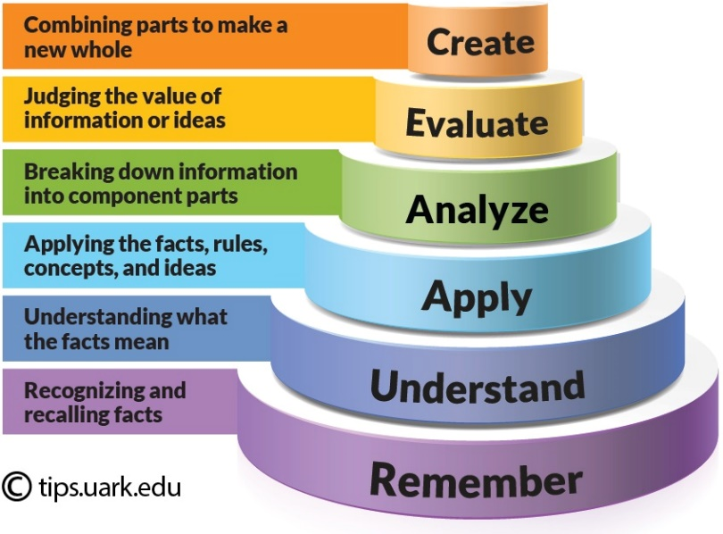
Revised Bloom’s Taxonomy
Bloom's Taxonomy is a framework for categorizing educational goals, It is widely used by educators to create learning objectives, assessments, and activities that encourage higher-order thinking. The taxonomy is typically represented as a hierarchical model with six levels:
Remembering: Recalling facts and basic concepts.
Example: Define, list, memorize, repeat, state.
Understanding: Explaining ideas or concepts.
Example: Describe, explain, interpret, summarize, classify.
Applying: Using information in new situations.
Example: Use, execute, implement, demonstrate, solve.
Analyzing: Breaking information into parts to explore understandings and relationships.
Example: Compare, contrast, examine, test, differentiate.
Evaluating: Justifying a decision or course of action.
Example: Critique, judge, argue, support, validate.
Creating: Producing new or original work.
Example: Design, construct, plan, produce, invent.

Slide 6
Course outcome
Through this course students should be able to:
CO1 :: apply basic HTML elements, CSS properties and Tailwind to create visually appealing web
pages.
CO2 :: create webpage using Tailwind CSS Concepts, Layout,Spacing, Sizing and Typography.
CO3 :: understand use JavaScript variables, functions, and events to enhance user interactivity
on web pages.

Slide 7
Course outcome
Through this course students should be able to:
CO4 :: evaluate HTML elements, handle events, and create dynamic web content using JavaScript and DOM.
CO5 :: create interactive web forms and validate user input to enhance form handling.
CO6 :: apply jQuery for efficient element manipulation and work with JSON objects for seamless data exchange.

Slide 8
Program Outcomes
PO1
Engineering knowledge: Apply the knowledge of mathematics, science, engineering fundamentals, and an engineering specialization to the solution of complex engineering problems.
PO2
Problem analysis::Identify, formulate, research literature, and analyze complex engineering problems reaching substantiated conclusions using first principles of mathematics, natural sciences, and engineering sciences.
PO3
Design/development of solutions::Design solutions for complex engineering problems and design system components or processes that meet the specified needs with appropriate consideration for the public health and safety, and the cultural, societal, and environmental considerations.
PO4
Conduct investigations of complex problems::Use research-based knowledge and research methods including design of experiments, analysis and interpretation of data, and synthesis of the information to provide valid conclusions.

Slide 9
Program Outcomes
PO5
Modern tool usage::Create, select, and apply appropriate techniques, resources, and modern engineering and IT tools including prediction and modeling to complex engineering activities with an understanding of the limitations.
PO6
The engineer and society::Apply reasoning informed by the contextual knowledge to assess societal, health, safety, legal and cultural issues and the consequent responsibilities relevant to the professional engineering practice.
PO7
Environment and sustainability::Understand the impact of the professional engineering solutions in societal and environmental contexts, and demonstrate the knowledge of, and need for sustainable development.
PO8
Ethics::Apply ethical principles and commit to professional ethics and responsibilities and norms of the engineering practice.
PO9
Individual and team work::Function effectively as an individual, and as a member or leader in diverse teams, and in multidisciplinary settings.

Slide 10
Program Outcomes
PO10
Communication::Communicate effectively on complex engineering activities with the engineering community and with society at large, such as, being able to comprehend and write effective reports and design documentation, make effective presentations, and give and receive clear instructions.
PO11
Project management and finance::Demonstrate knowledge and understanding of the engineering, management principles and apply the same to one’s own work, as a member or a leader in a team, manage projects efficiently in respective disciplines and multidisciplinary environments after consideration of economic and financial factors.
PO12
Life-long learning::Recognize the need for, and have the preparation and ability to engage in independent and life-long learning in the broadest context of technological change.

Slide 11
Skill Attainment
Technical Skills:
HTML CSS and JavaScript
Tailwind CSS and GitHub
DOM and JQuery
Soft Skills:
Creativity, Time management, Adaptability.
Problem-solving, Continuous Learning.

Slide 12
Course contents
Unit I
Introduction to HTML and CSS : Fundamentals of HTML, Creating Style Sheet, CSS Box Model Border properties, CSS selectors like type, id, class, Types of CSS, CSS Grid introduction, Creating different layouts for webpage, Introduction to GitHub and repository hosting
Unit II
Introduction to Tailwind CSS:-Core Concepts and Layout : Tailwind CSS Display and Visibility, Tailwind CSS Float, Tailwind CSS Clear, Tailwind CSS Layout, Tailwind CSS Z-index, Tailwind CSS Object Fit and Object Position, Tailwind CSS Flex, Tailwind CSS Grid, Justify and Align, Overview of Tailwind CSS., Tailwind CSS Container, Tailwind CSS Sizing

Slide 13
Course contents
Unit III
Styling and Enhancements:-Spacing, Sizing, Typography : Tailwind CSS Alignment, Tailwind CSS Spacing, Tailwind CSS Sizing, Tailwind CSS Typography, Tailwind CSS Backgrounds
Unit IV
Core JavaScript Fundamentals and Interactivity : Incorporating JavaScript in the HEAD and BODY element, Using an External JavaScript file, Variables and Operators, Control Statements, Looping Statements, Popup Boxes, JavaScript Objects, Working with Functions

Slide 14
Course contents
Unit V
DOM Manipulation and JavaScript Web Forms : Introduction to the DOM and its role in web development, Accessing and manipulating DOM elements using JavaScript., Programming HTML DOM with JavaScript, Modifying HTML content and attributes through JavaScript., Dynamic styling and manipulation of elements., Event Handling in JavaScript, Assigning event handlers using DOM object properties., Using addEventListener and removeEventListener for event management., Understanding and implementing event bubbling in JavaScript., Creating an interactive image gallery using DOM manipulation and event handling, Implementing thumbnail previews and lightbox-style image display., Fetching and displaying user location using the Geolocation API., Handling permission requests and errors with geolocation.
Unit VI
Working with jQuery and JSON : Basics of jQuery, jQuery Events, Benefits of using CDN, jQuery Selectors, jQuery input vs :input, jQuery DOM manipulation methods, jQuery Elements, Working with JSON Objects, JSON Arrays, Nested JSON object, Conversion of JSON object to string, Conversion of string to JSON object, jQuery DOM manipulation methods Working with JSON Objects, Introduction to revenue generation based project

Slide 15
List of practical's
Design web page using table and list concept in HTML.
Design web page using images, links and frames in HTML.
Design forms and perform various types of validations in HTML.
Design attractive web page using CSS and JavaScript.
Implement the concept of event handlers in JavaScript using DOM object property
Implement event bubbling in JavaScript.
Make Image gallery with thumbnails in JavaScript
Design web page using jQuery Selectors and elements.
Use JSON objects, arrays and string concept in your web pages.

Slide 16
List of practical's
Design customizable website using Bootstrap Grid System and Typography.
Implement Bootstrap list, table, buttons and dropdowns.
Create a Responsive Portfolio Section using Tailwind CSS
Create a Responsive Contact Form using Tailwind CSS
Create a JavaScript file (script.js) to handle the geolocation functionality

Slide 17
Assessment/Evaluation Scheme
Attendance: 5%
CA: 45%
MTT: No MTT
ETP: 50%

Slide 18
Assessment/Evaluation Scheme
CA1: 30 marks (Visual Implementation)
CA2: 30 marks (Project)
Note: No MOOC Certification is Applicable

Slide 19
CA 2 – Project Rubrics
Functionality (5),
User Interface(5),
Report (10),
Presentation(10),
Optional
Client Involvement component with Revenue Generation will be given opportunity to earn upto 10 marks.

Slide 20
Software's
Standard Editor :-
VS-Code.
Online Editor :–
CodeSandbox
CodePen

Slide 21
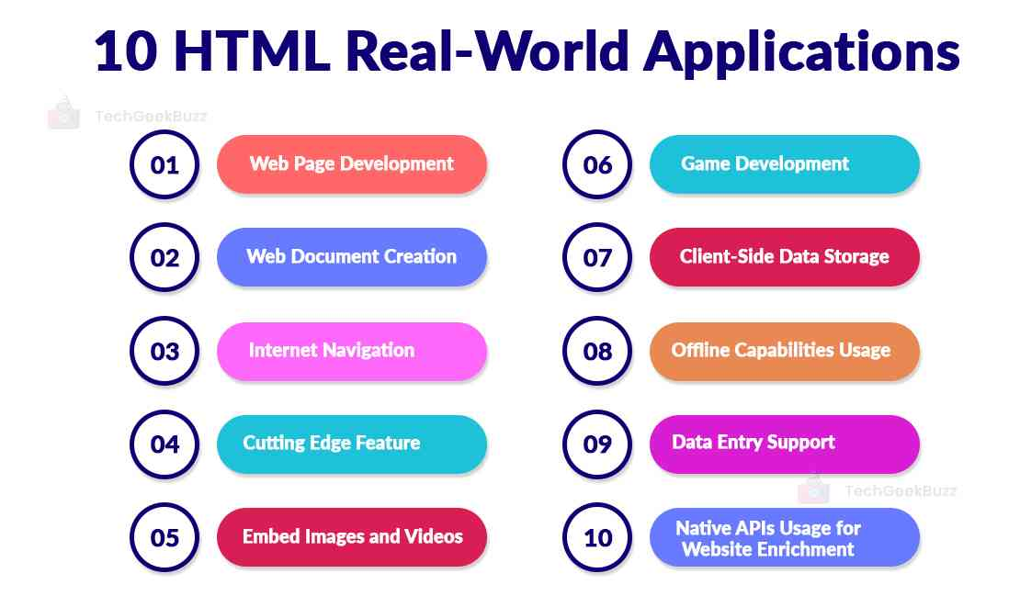
Real World Applications

Slide 22
Books
Text Books:
MASTERING HTML, CSS & JAVA SCRIPT WEB PUBLISHING by LAURA LE MAY, RAFE COLBURN, JENNIFER KYRNIN, BPB PUBLICATIONS
MASTERING HTML, CSS & JAVA SCRIPT WEB PUBLISHING by LAURA LEMAY, RAFE COLBURN, JENNIFER KYRNIN, BPB PUBLICATIONS
Reference Book:
ULTIMATE TAILWIND CSS HANDBOOK by KARTIK BHAT, AbeBooks
HTML5 BLACK BOOK by KOGENT LEARNING SOLUTIONS INC., DREAMTECH PRESS

Slide 23
Online Education Resources
https://www.w3schools.com/Html/.
https://www.w3schools.com/css/.
https://tailwindcss.com/docs/installation
https://www.w3schools.com/js/
https://www.w3schools.com/js/js_htmldom.asp .
https://jquery.com/ .
https://www.w3schools.com/jquery/default.asp.
https://docs.github.com/en/get-started/using-git/pushing-commits-to-a-remote-repository

Slide 24
Next Class: Introduction HTML and CSS

